Slide 1
CS2303: Systems Programming Concepts
Class 16.5
Derived Classes in C++
Thanks for Prof. Lauer for an earlier version of these slides.
Copyright 2005-2017, Michael J. Ciaraldi

Slide 2
Outline
Introduction
Base Classes and Derived Classes
Some Examples of Base Class and Derived Class Relationships
Constructors and Destructors in Derived Classes
Accessing Members of Base and Derived Classes

Slide 3
Reading Assignment
Absolute C++, Chapter 14
A lot of similarities to Java
Some differences

Slide 4
History
The whole notion of classes, subclasses, and inheritance came from Simula 67
A generalization of notion of records (now known as structs) from Algol- and Pascal-like languages in 1960s and early 70s
A (very nice) programming language developed in Norway for implementing large simulation applications
By O.-J.Dahl, who later co-authored the influential book Software Engineering with E. Dijkstra and T.Hoare.

Slide 5
Terminology
Inheritance is a form of software reuse where a new class is created to
absorb an existing class’s data and behaviors, and
enhance them with new capabilities
The new class, the derived class, inherits the members of the existing class, known as the base class

Slide 6
Terminology (continued)
C++ | Java
Derived Class | Subclass
Base Class | Superclass
Abstract Class | Abstract Class
Virtual Function | Method
Pure Virtual Function | Abstract Method

Slide 7
Terminology (continued)
A direct base class is the base class from which a derived class explicitly inherits.
An indirect base class is inherited from two or more levels up in the class hierarchy.
In single inheritance, a class is derived from one base class.
With multiple inheritance, a derived class inherits from multiple base classes.
Java does not have this, but…

Slide 8
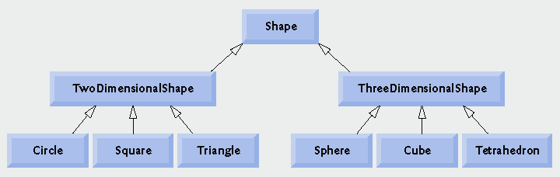

Class Hierarchy

Slide 9
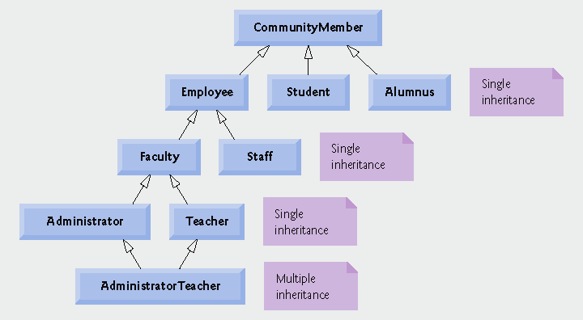
Another Class Hierarchy
Members of a university community
Note two separate base classes

Slide 10
Types of Inheritance in C++
public: every object of a derived class is also an object of its base class
Note, base-class objects are NOT objects of their derived classes.
private: is essentially an alternative to composition
I.e., derived class members not accessible from outside
protected:
Protected members are used frequently; however …
Protected inheritance is not frequently used.

Slide 11
Example — public class
class Employee { string givenName, familyName; date hiringDate; short department; ...
};
class Manager: public Employee { set <Employee *> group; short level; ...
}
All Managers are Employees but not all Employees are Managers

Slide 12
Example — public class
class Employee { string givenName, familyName; date hiringDate; short department; ...
};
class Manager: public Employee { set <Employee *> group; short level; ...
}
Note: this is an example of the use of a container class from Standard Template Library

Slide 13
Important Note
Member functions of derived class cannot directly access private members of base class
Example:–
Manager member functions in previous example cannot read manager’s own name!
Because data members of a class are by default private

Slide 14
protected: Access Specifier
class Employee {
protected: string givenName, familyName; date hiringDate; short department; ...
};
class Manager: public Employee { set <Employee *> group; short level; ...
}

Slide 15
protected (continued)
A base class’s protected members can be accessed by
members and friends of the base class, and
members and friends of any class derived from the base class.
Derived-class member functions can refer to public and protected members of the base class.
By simply using their names

Slide 16
Inheritance and Composition

Slide 17
Difference between Inheritance and Composition
is-a relationship:– inheritance
e.g., derived class object, car, is an object of the base class vehicle
e.g., derived class object, Manager, is an object of the base class Employee
is-a a.k.a. isA a.k.a. Liskov principle.
has-a relationship:– composition
e.g., a TreeNode object has (i.e., contains) a member object of type string

Slide 18
Base Classes and Derived Classes
Base classes typically represent larger sets of objects than derived classes
Example
Base class: vehicle
Includes cars, trucks, boats, bicycles, etc.
Derived class: car
a smaller, more-specific subset of vehicles

Slide 19
Base Classes and Derived Classes (continued)
I.e., base classes have more objects
But fewer data and function members
Derived classes have only subsets of the objects
Hence the term subclass
But a derived class may have more members — both data and function members

Slide 20
Digressions

Slide 21
Digression – Code Re-use
Fundamental principle of software engineering
A body of code is a living, evolving thing
As a practical matter, copies of code cannot keep up with each other
If you really want your hard work to support multiple purposes, applications, requirements, etc.
You really need a way for those purposes to inherit your code rather than copy it.

Slide 22
Constructors and Destructors
Constructor:–
Derived class constructor is called to create derived class object
Invokes base class constructor first
Before derived class initializer list & constructor body
… and so on up class hierarchy
Destructor:–
Derived class destructor body is executed first
Then destructors of derived class members
And then destructor of base class
… and so on up class hierarchy

Slide 23
Instantiating a Derived-class Object
Derived-class constructor invokes base class constructor either
implicitly (via a base-class member initializer) or
explicitly (by calling the base class’s default constructor)
Base of inheritance hierarchy
Last constructor called in inheritance chain is at base of hierarchy
Last constructor is first constructor body to finish executing

Slide 24
Example
class Employee { string name; int dept;
public: Employee(const string s, int d);
}
class Manager: public Employee { int level;
public: Manager(const string s, int d, int lvl);
}
Employee::Employee (const string s, int d): name(s), dept(d) { … }
Manager::Manager (const string s, int d, int lvl): Employee(s, d), level(lvl) { … }
Note: Java uses super() instead of base class name
to invoke parent constructor.

Slide 25
Recap
Absolute C++, §14.1
When creating a derived-class object:–
Derived-class constructor immediately calls base-class constructor
Base-class constructor executes
Derived class member initializers execute
(Finally) derived-class constructor body executes
If your constructor does not invoke the base class constructor explicitly, …
… the compiler will generate code to invoke the base class default constructor as first step in initialization

Slide 26
Recap
Absolute C++, §14.1
When creating a derived-class object:–
Derived-class constructor immediately calls base-class constructor
Base-class constructor executes
Derived class member initializers execute
(Finally) derived-class constructor body executes
This process cascades up the hierarchy if the hierarchy contains more than two levels.

Slide 27
Constructors and Destructors in Derived Classes
Destroying derived-class objects
Reverse order of constructor chain
Destructor of derived-class called first
Destructor of next base class up hierarchy is called next
This continues up hierarchy until the final base class is reached.
After final base-class destructor, the object is removed from memory
Base-class constructors, destructors, and overloaded assignment operators are not inherited by derived classes.

Slide 28
Remember
When a class contains* members of other classes …
… contructors of those members are called before class constructor body
Either in initializer list
… or by default
Apply same rule to members of base class!
* I.e., has variables containing the other class, not pointing to the other class.

Slide 29
Remember
Destructors for derived-class objects are called
… in reverse order from which
… corresponding constructors were called.

Slide 30
Redefining Base Class Members

Slide 31
Redefinition of Base Class Members
Suppose that base class has a member
E.g. void print()
Knows only how to print information from base class
Define same member in derived class
E.g. void print()
Knows how to print info for derived class
Needs to call base class print() function to print base class info

Slide 32
Redefinition of Base Class Members (continued)
Derived class
void print() { // print derived class info BaseClass::print(); //prints base info // more derived class stuff
}
See Absolute C++, §14.1
General principle:– when in derived class scope, if you need to access anything in base class with a naming conflict, use '::' scope resolution operator

Slide 33
Accessing Members of Base and Derived Classes
Let B be a base class with public members m and n
Let D be a derived class with public members m and p
I.e., D redefines member m
E.g., print() function of previous example
Consider the following:–
B objB;
D objD;
B *ptrB;
D *ptrD;
Copy to white board!

Slide 34
Accessing Members (continued)
objB.m and objB.n are both legal
access members of base class
objD.m and objD.p are both legal
access members of derived class
objD.n is also legal
accesses member of base class!
objB.p is not legal
Class B has no member named p!

Slide 35
Accessing Members (continued)
ptrB = new B();
ptrB -> m and ptrB -> n are both legal
access members of base class
ptrD = new D();
ptrD -> m and ptrD -> p are both legal
access members of derived class

Slide 36
Accessing Members (continued)
ptrB = ptrD;
ptrB now points to an object of the derived class
which by definition is an object of the base class!
ptrB -> m and ptrB -> n are both legal
access members of base class object
Even though object pointed to is an object of derived class, with its own redefined member m!

Slide 37
Accessing Members (continued)
ptrB = ptrD;
ptrB -> p is not legal
Because ptrB only knows about B’s members!
Rule:–
So far, which member to access depends entirely on the type of the accessing pointer (or accessing object)
To bend that rule, need polymorphism and virtual members.
Java avoids this distinction: All members are virtual.

Slide 38
Loose Ends

Slide 39
Loose End:– Three Types of Inheritance in C++
public: every object of a derived class is also an object of its base class
Note, base-class objects are NOT objects of their derived classes
private: is essentially an alternative to composition
I.e., derived class members not accessible from outside
protected: not often used (as a type of inheritance)
Even though protected members are used all the time.

Slide 40
Let D be derived from B
If B is a private base class:–
I.e., class D: private B {}
Public and protected members of B can only be used by member and friend functions of D.
Only members and friends of D can convert D* into B*
Outside of member and friend functions of D
Dptr -> p is not allowed (where p is a member of B)
Bptr = Dptr is not allowed

Slide 41
To clarify …
Member functions of D can only reference public and protected members of B
Users of D cannot even see the public and protected members of B …
… because B is a private base class

Slide 42
Let D be derived from B (continued)
If B is a protected base class:–
I.e., class D: protected B {}
Public and protected members of B can only be used by member and friend functions of D and also by member and friend functions of classes derived from D
Only members and friends of D and its derived classes can convert D* into B*
I.e., outside of member and friend functions of D or its derived classes
Dptr -> p is not allowed (where p is a member of B)
Bptr = Dptr is not allowed

Slide 43
Let D be derived from B (continued)
If B is a public base:–
I.e., class D: public B {}
Public members of B can be used by any function
Protected members of B can be used by member and friend functions of D and also by member and friend functions of classes derived from D
Any function can convert D* into B*
I.e.,
Dptr -> p is allowed (where p is a member of B)
Bptr = Dptr is allowed

Slide 44
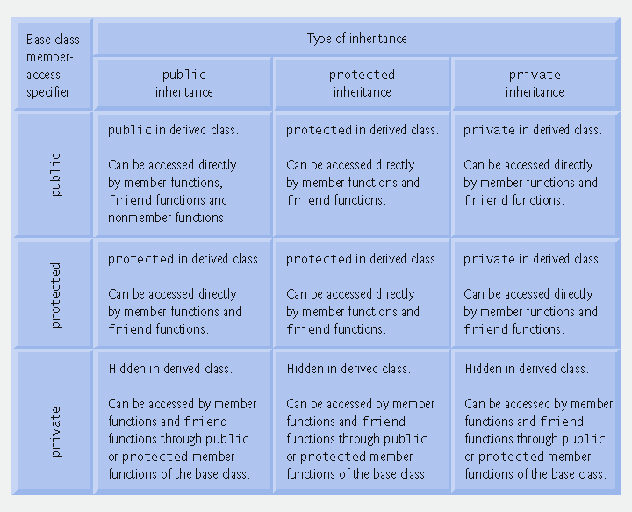
Summary of Inheritance
This chart does not capture the difference between private and protected inheritance.

Slide 45
Summary – Inheritance
This topic covered the basics of inheritance in C++
There is much, much more to say about inheritance after we cover polymorphism

